Slide 1




Multi lingual large language models for everything
Jayveersinh Raj
j.raj@innopolis.university
Evgenii Evlampev
e.evlampev@innopolis.university

Slide 2
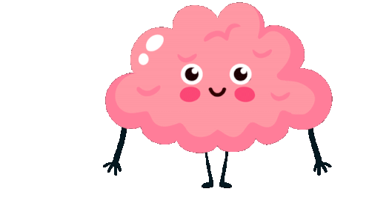
Background
Due to high knowledge base from pretraining large language models holds great potentials beyond chatting. For example, a large language model can be used for translations, classifications, answering response based on context, etc. Hence, a single large language can replace many models for different tasks, and performs in some cases significantly better.

Slide 3


1. Intro
We used a technique called Parameter efficient fine tuning (PEFT) to create adapter on the same base model with low rank adaptation (LoRA) with quantization (QLoRA) on the following tasks:
Sentence correction Correction of incorrect sentences/words.
Question Answering A chat like to and fro with the model, context can also be optionally given.

Slide 4
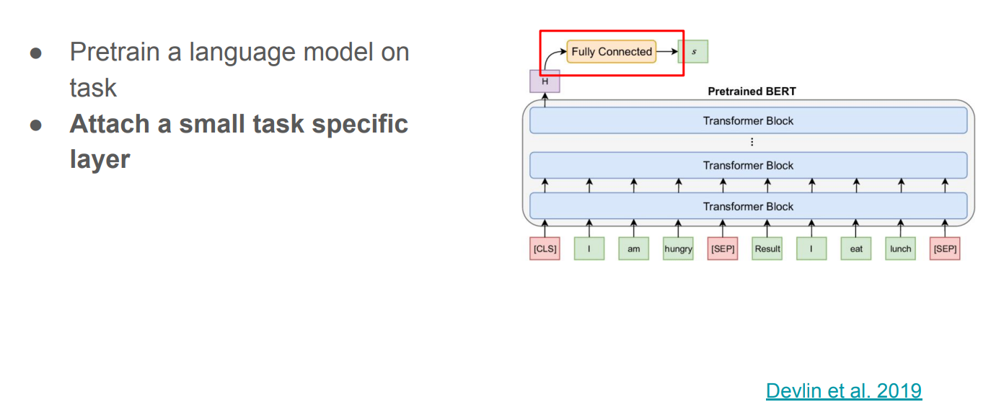
Fine tuning
Tip
In this example, we’re leading off with something unexpected.
While the audience is trying to come up with a number, we’ll surprise them with the next slide.

Slide 5
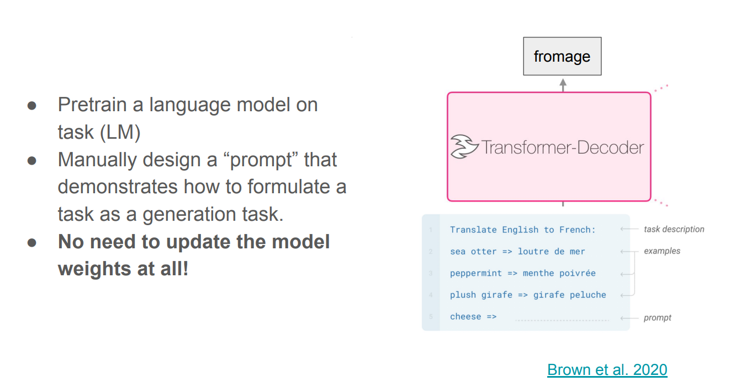
In context learning
Tip
Remember. If something sounds like common sense, people will ignore it.
Highlight what is unexpected about your topic.

Slide 6
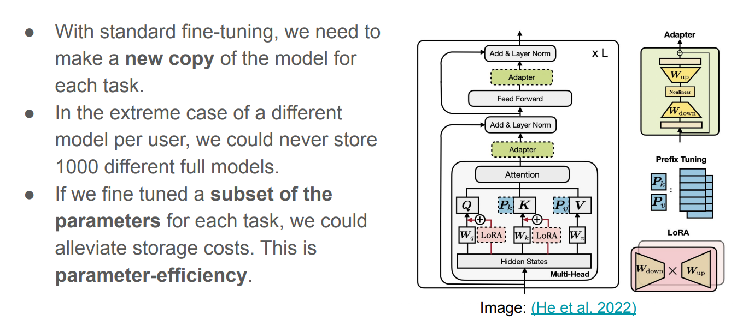
Parameter efficient fine tuning

Slide 7
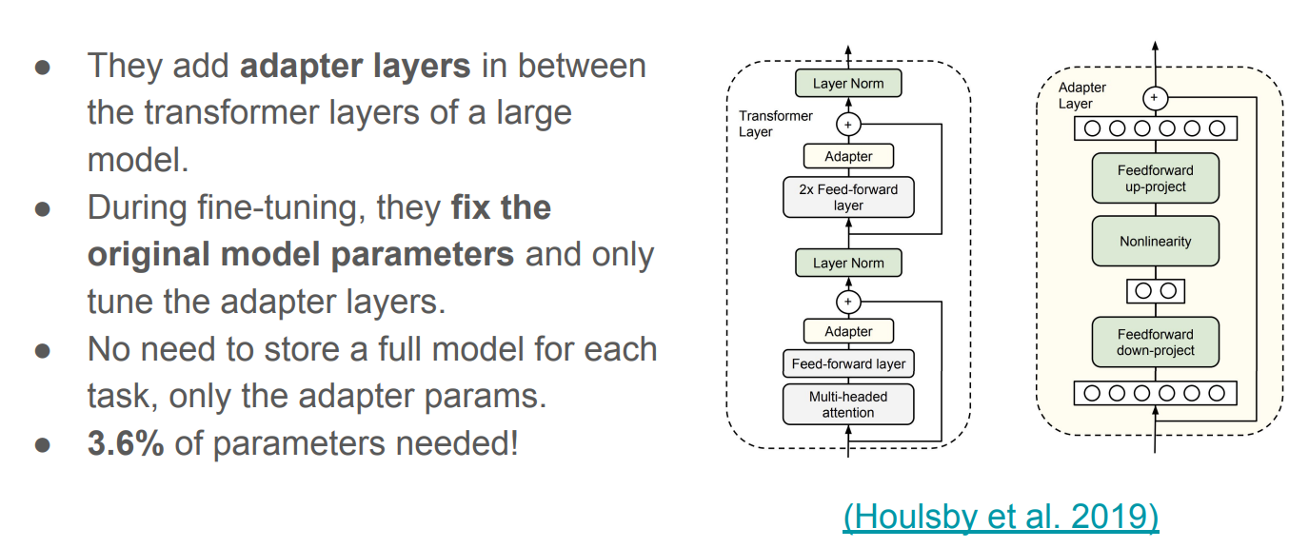
Adapter fine tuning

Slide 8

Multilinguality
Due to training data in multiple languages, the model can perform a task in multiple languages irrespective of the dataset used to fine tune the adapter layers. In our sentence correction task we used Gujarati dataset with 1000 points, which was 0.3% of the training data in the base model of Bloom 3b, yet we get significant results.

Slide 9
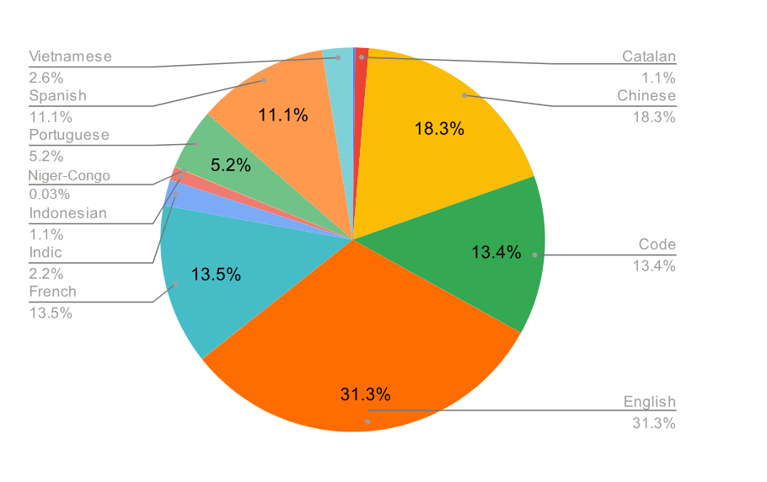
Training data share for Bloom-3b

Slide 10
2. Results
On Bloom-3b (8 bit quantized) prompt tuned
Sentence correction 70-75% on all the ROUGE scores. For 100 samples in English.
Question Answering Unable to test because of hardware limitations, but answers seems relevant.

Slide 11
3. Examples
The following slides contains example output generated by the model.

Slide 12

Sentence correction
In English ‘read’ has a past tense and past particle unchanged in writing, but is pronounced ‘red’.
Story for illustration purposes only

Slide 13
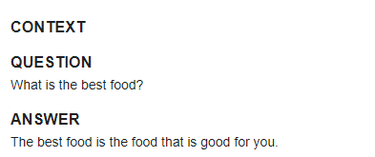
Question Answering
We asked a model to suggest the best food without any context, and here is what the model has for us

Slide 14

HuggingFace:
Jayveersinh-Raj/bloom-sentence-correction
Jayveersinh-Raj/bloom-que-ans

Slide 15

We are ready for the questions!
Thank you!

